Slide 1
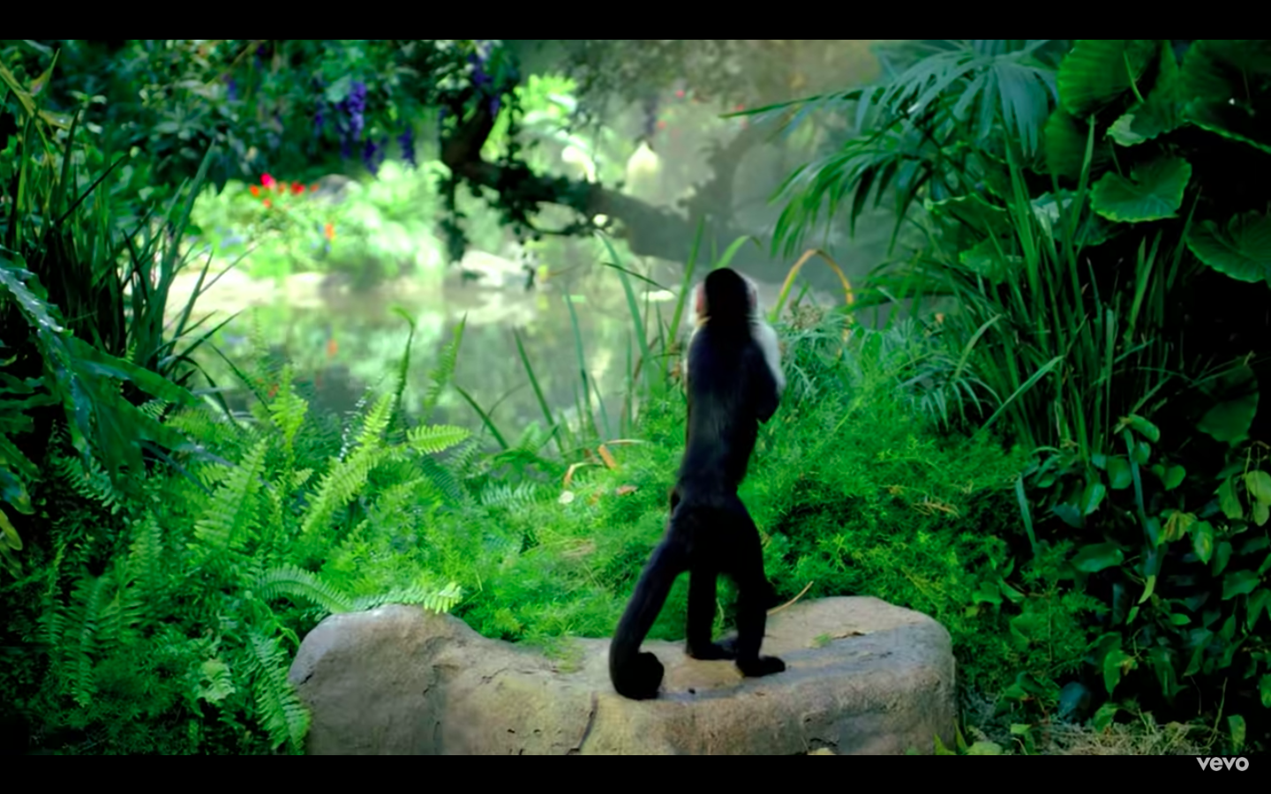
Dark Horse | Roar | Last Friday Night
Firework | Hot N Cold | Part Of Me
Swish Swish | Smile | Birthday
Rise | 365 | Cozy Little Christmas

Slide 2
Dark Horse | Roar | Last Friday Night
Firework | Hot N Cold | Part Of Me
Swish Swish | Smile | Birthday
Rise | 365 | Cozy Little Christmas

Slide 3
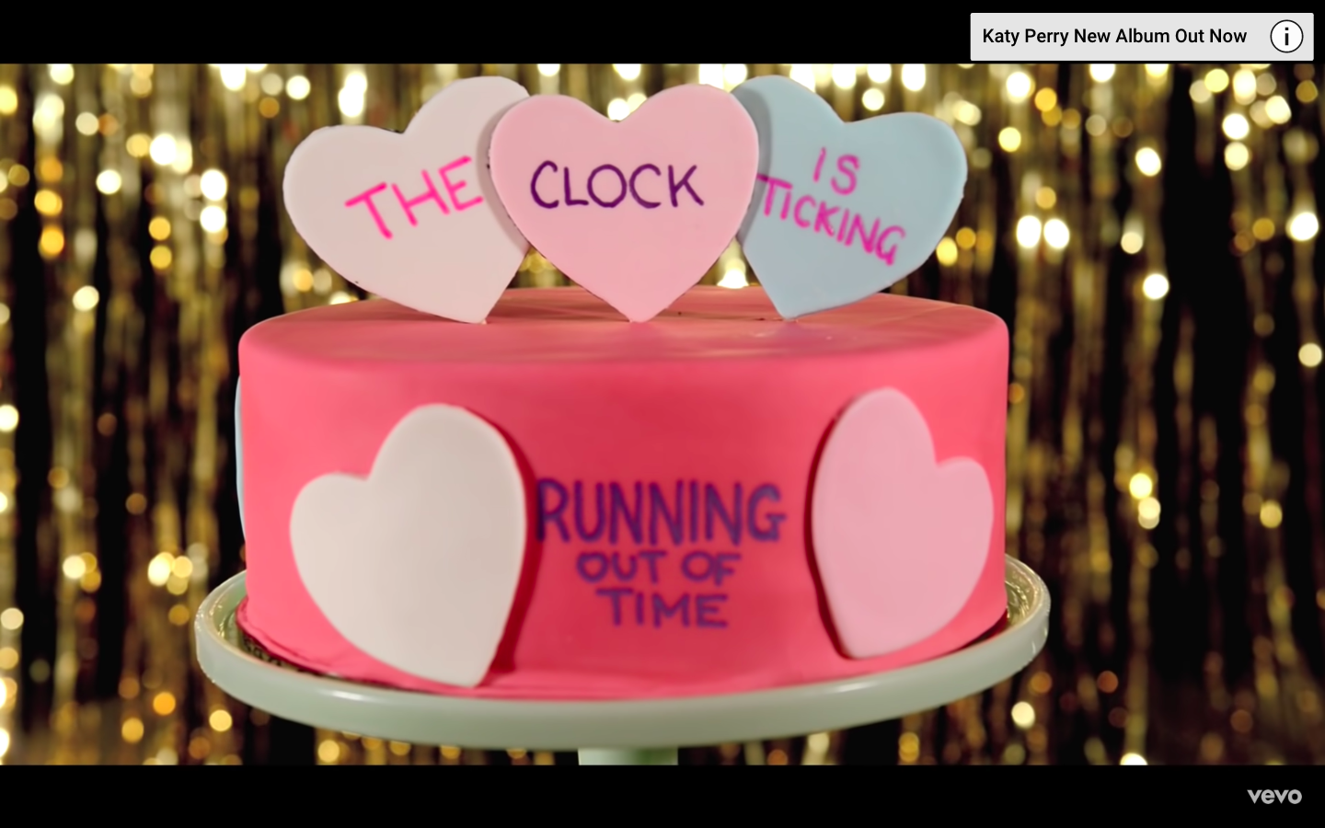
Dark Horse | Roar | Last Friday Night
Firework | Hot N Cold | Part Of Me
Swish Swish | Smile | Birthday
Rise | 365 | Cozy Little Christmas

Slide 4
Dark Horse | Roar | Last Friday Night
Firework | Hot N Cold | Part Of Me
Swish Swish | Smile | Birthday
Rise | 365 | Cozy Little Christmas

Slide 5
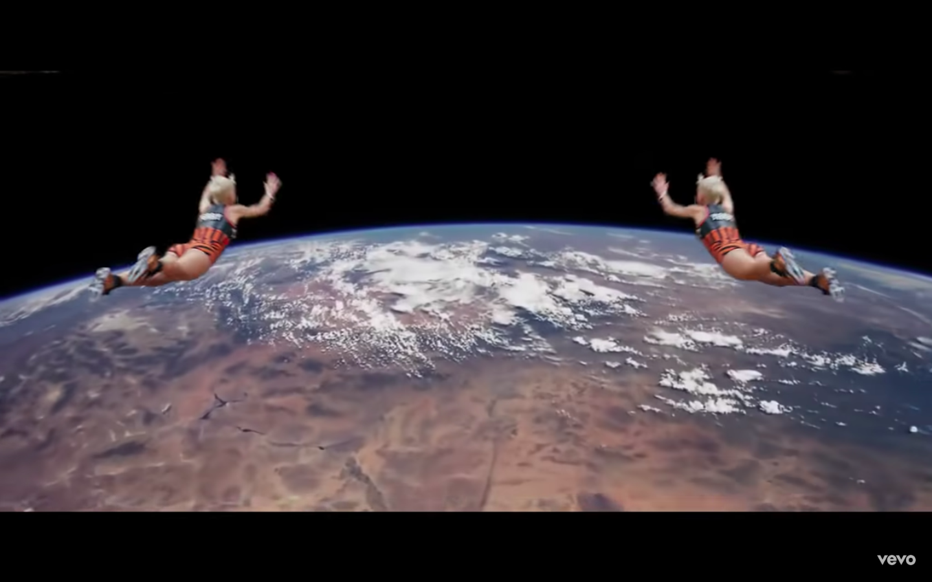
Dark Horse | Roar | Last Friday Night
Firework | Hot N Cold | Part Of Me
Swish Swish | Smile | Birthday
Rise | 365 | Cozy Little Christmas

Slide 6
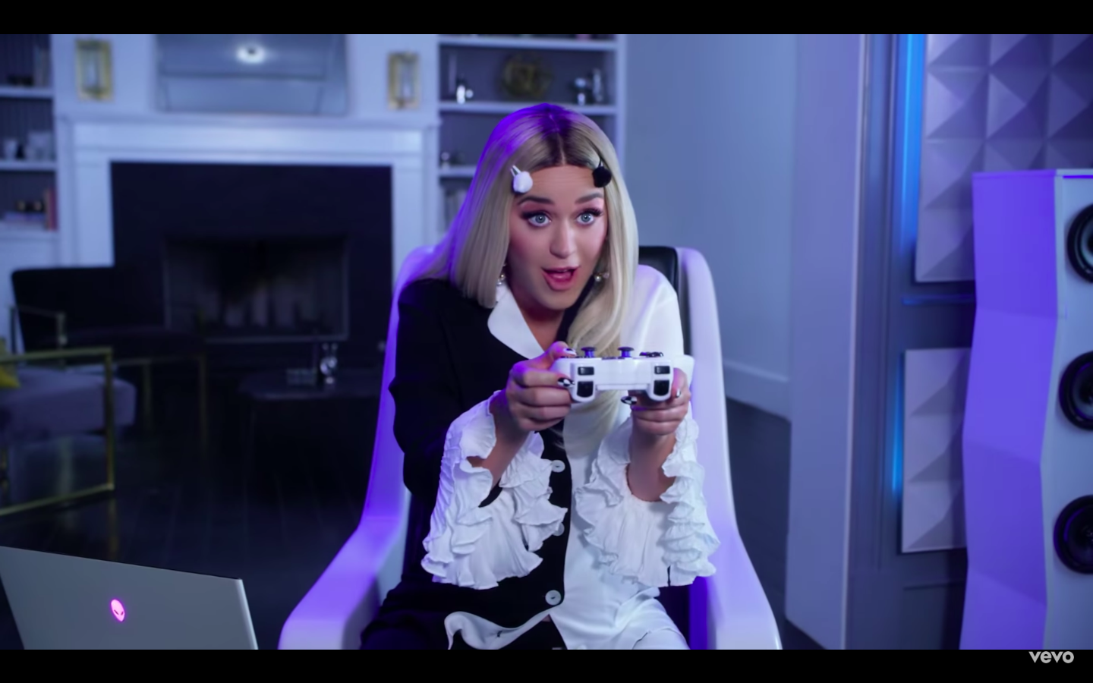
Dark Horse | Roar | Last Friday Night
Firework | Hot N Cold | Part Of Me
Swish Swish | Smile | Birthday
Rise | 365 | Cozy Little Christmas

Slide 7
Dark Horse | Roar | Last Friday Night
Firework | Hot N Cold | Part Of Me
Swish Swish | Smile | Birthday
Rise | 365 | Cozy Little Christmas

Slide 8
There's a s_____________ in my bed There's a pounding in my h_________ Glitter all over the room
Last Friday Night

Slide 9
Yeah, we maxed our c_______ cards And got kicked out of the b_____ So we hit the boulevard
Last Friday Night

Slide 10
Last Friday night Yeah, we danced on t______________ And we took too many shots Think we kissed, but I f__________
Last Friday Night

Slide 11
All your insecurities
All the d_______ ____________
Never made me blink one time
Unconditionally

Slide 12
I'll take your ______ days with your good Walk through the s________, I would
I do it all because I love you
Unconditionally

Slide 13
I just wanna throw my p________ away
Find out who is really there for me
You ripped me off, your love was ________
Part of me

Slide 14
This is the part of me
That you're never gonna ever _____ _____ from me, no
Throw your sticks and your s_________
Throw your b_______ and your blows
Part of me

Slide 15
I don't need __________, no sparkly things
'Cause you can't buy this a ___________
Little Cozy Christmas

Slide 16
I don't need anything
Take back all the Cartier, and the T________ and the ___________
Well, can I keep that _______? Please?
Little Cozy Christmas

Slide 17
Sure it's madness, but it's ________
As soon as you hang up the m_________
'Cause you're the reason for the _________
Little Cozy Christmas

